Slide 1
Day 3 afternoon:
Finding the Right Problem to Work on through Quick & Dirty Pilots
Prof. Shengdong Zhao
Notes:
Hello everyone. This is group3 I am wangbo. Today, our group will give u an introduction about how to find the right problem to work on throught quick and dirty pilots.

Slide 2
Next steps
Problem selection
Pilot study design
Conduct the pilots and analyze results
Transition to stage 2
Notes:
To find a right problem to work on , you have four steps. First, you have to do problem selection, then pilot study design, and then conduct the pilots and analyze results. Finally, transition to stage two

Slide 3
Problem selection:
Quick & Dirty Pilot Study:
PilotAR introduction:
Notes:
First, I will talk about how to select a problem. My friend Jiele Nd Ayush will introduce the pilot study design.

Slide 4

Problem Selection
Interestingness Check
High Level Principle
Feasibility Check
Notes:
For the problem selection, we first need to propose a lot of problems and then we can look through them and do elimination on them, so that we can find the most appropriate one to work on. The high level principle of elimination contains two parts: The interestingness Check and the Feasibility Check.

Slide 5
Problem Selection - High Level Principle
First eliminate less interesting problems
Second eliminate less feasible problems
Estimated gain of the problem
Attractiveness of a problem =
Estimated cost of the problem
Note: Problem selection is half of the success! So pay extra attention to it!
Notes:
Once we find some interesting problems, the next step is to eliminate less feasible problems. Then, once you have identified some interesting problems, the next one is to eliminate less feasible problems. There is a rough formula for defining how to prioritize a selection.
.
The attractiveness of a problem is the estimated gain of the problem by the estimated cost of the problem. So we need to maximize the contribution and minimize the cost.
Problem selection is half of the success! Even more than that. If you choose the right problem to work on, you will find the rest is quite smooth and easy. If you start with a difficult problem, your process will be very rough.

Slide 6
Problem Selection - High Level Principle
Note: Learn to solve “easier” problems first before moving onto harder problems!
As a beginner, your goal:
Learn the process
Gain your skills
Enhance your understanding
Notes:
Yes. Everyone wants to choose an easy problem. But there are not easy problems if u want to publish a paper on top conferences. Rember not to try to find an easy problem but an easier problem to solve. As a beginner, we learn how to walk before learning how to run. Our goal is to learn the whole process of doing HCI research, gain some skills that are useful, and enhance our understanding of one domain or area. After that, we can move to harder problems.

Slide 7
Assumptions before proceed to pilot studies
You have done your literature review and know what has been done.
You have done a brainstorming session can come up with a set of “new” ideas based on the best of your knowledge.

Slide 8
Problem Selection - Interestingness Check
Here are the recommended steps:
First check: has the problem been investigated before?
If the answer is yes, can I contribute “significant” new insights? If no, eliminate this problem!
Second check: is the implication of the result significant? ( or have important practical implications)?
If the answer is no, eliminate this problem!
Third check: Is the applicability of the result generalizable?
If the answer is no, you may want to reconsider it depending on how important is its implications
Two other aspects of interestingness based on previous lectures.
Is the result obvious (or surprising)?
Is the result simple (or complex)?
If your problem pass the first three criteria, the chance is we can find less obvious and more complex results if we dig deep enough into the problem.
Notes:
Has the problem been investigated before?
If the answer is yes, can I contribute “significant” new insights? If not, eliminate this problem!
In some popular domains, there are so many researchers working on similar things as you. If you find a problem, please do enough review to understand this problem has not been investigated before. You need to do a solo review on your topic first, to become a domain expert, once you become a domain expert for a particular topic, anything you propose has a higher chance of being new. Please avoid spending much time on a topic that has been investigate befor. It is a waste of time.
Is the implication of the result significant?
If the answer is no, eliminate this problem
Do not spend a lot of time working on something normal, but nobody cares.
In fact, there are many angles to look at a problem, some problems maybe not be interesting to certain people but interesting to some people. So Finding an angle can justify there are enough people who care about it.
Is the applicability of the result generalizable?
There are some problems that are interesting but they are very narrow and focus just on a very specific area. They are publishable but you will receive tiny citations. Looking for something more generalizable that more people care about the results. This can boost your career.
There are also two other aspects of interestingness mentioned in lecture 3. Is the result obvious (or surprising)? Is the result simple (or complex)?
These also determine whether your paper gets accepted. We need to care about these.
The interestingness of these two aspects depends on your investigation. If your problem passes the first three criteria, we usually find less obvious and more complex results if we dig deep enough into the problem.

Slide 9
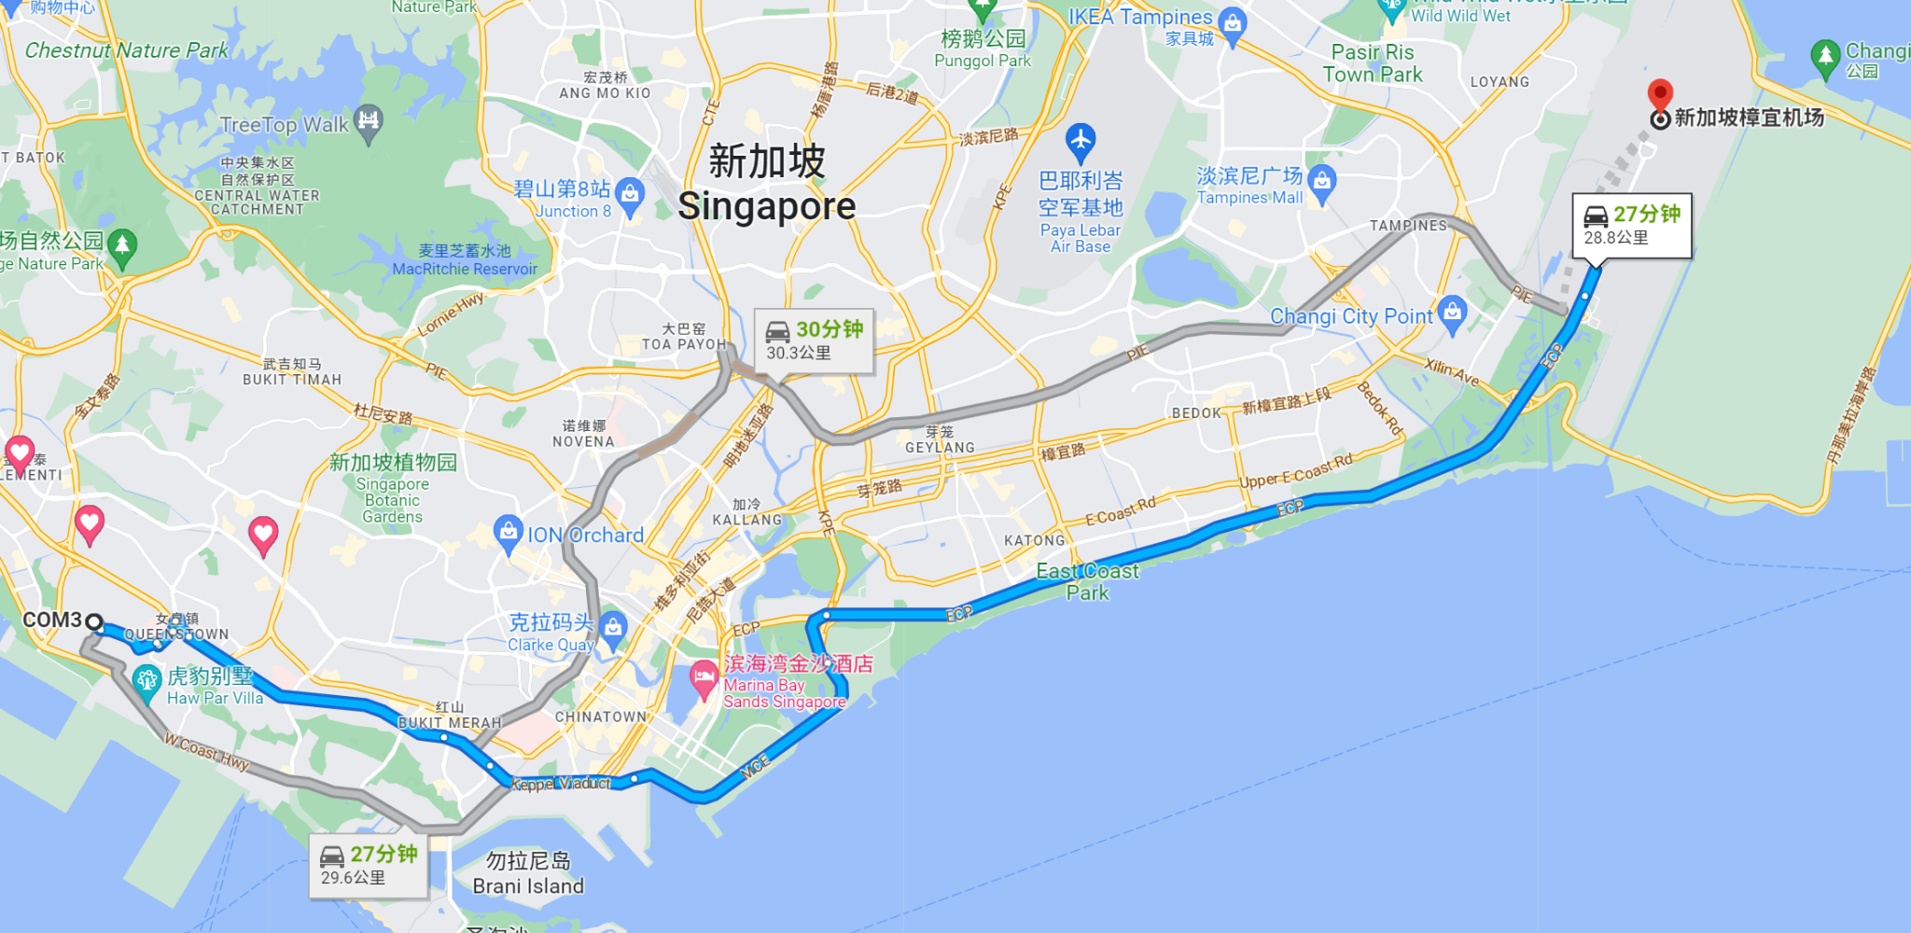
Problem Selection - Interestingness Check - Example
Help drivers in the rush hours to find out the fastest way while driving for time saving and safe driving.
Input: driver’s location, road info from server, camera to get the picture of the current road situation.
Audio info to get the prefer of the driver(fastest/shortest/good road condition)
Output: Marco&Micro
Complete route present by figure.
Direction(turn left/right/go straight), both sign and audio available.
Challenge: Only this may not be superior to current navigation considering the cost of developing new techniques. So it needs to be more versatile and can achieve more things including controlling facilities in the car.
Notes:
I select this example from the brainstorming of our lecture.

Slide 10

https://pollev.com/szhao168
Q7

Slide 11
Problem Selection - Feasibility Check
How to define feasibility?
Criteria no. 1: do I have access to the participants?
Rule of thumb: unless you have worked with them before and have access, avoid “special populations”.
E.g., people with disabilities, certain careers (doctors, politicians), etc.
Criteria no. 2: do I have access to such technology and equipment?
Rule of thumb: unless you have used them before and have access, avoid special technology or equipment
E.g., research involves vehicles, MRI, etc.
Criteria no. 3: its measure is well defined in literature
Rule of thumb: pick known measures that’s well established in literature. Avoid ambiguous effects unless that’s your main contribution
E.g., mindfulness, cognitive load are less defined as compared with speed, accuracy, learnability, etc.
Criteria no. 4: can its effects be realistically estimated without programming or hardware development?
Rule of thumb: pick problems in which its effects can be easily tested with simulations. Avoid problems that requires heavy investment in the beginning to understand its effects.
Notes:
Assuming that you have found a work that is interesting enough to work on. We need to decide the feasibility.
There are several criteria to check feasibility.
Criteria no. 1: do I have access to the participants?
We need real users for HCI. Avoid “special populations”, Unless you have worked with them before and have access. Because finding enough special users, people with disabilities, certain careers (doctors, politicians), etc. is very difficult, especially in countries with small populations. Just to find the right user to test it with you
Criteria no. 2: do I have access to such technology and equipment?
Please avoid using special technology or equipment, unless you have used them before and have access. In HCI, everything that you want to publish at top conferences requires you to test in the real world. For example, avoid designing something related to vehicles and MRI, because they are expensive.
Criteria no. 3: its measure is well-defined in literature
Pick known measures that are well-established in the literature. Avoid ambiguous effects unless that’s your main contribution. For example, Engagement, mindfulness, and cognitive load are less defined as compared with speed, accuracy, learnability, etc. You may say that I find invent my own measure. Inventing your own measure is a high risk that people we will question your validity. It is much safe to use something that has already been established in the literature. So, you should do a literature review on that if there is already established measure both quantitatively and qualitatively and whether is easy to carry out.
Criteria no. 4: can its effects be realistically estimated without programming or hardware development?
Pick problems in which its effects can be easily tested with simulations. Avoid problems that require heavy investment in the beginning to understand their effects. If it requires a long feedback cycle to get any insights, then the risk is too high. You may have to program for a month before you can test it. Please remember to avoid spending too much energy on the stage before you can get any insights

Slide 12

Problem Selection - Feasibility Check-Example
Help homeowners at home building ikea furniture while getting context aware step-by-step instructions for building ikea furniture.
Input: context awareness
Output: just-in-time instructions
Challenges:
What is the most appropriate input modality for figuring out user context (ie. assembly stage). How to present information to the user? Visual? Auditory? What kind of output best suits the scenario of presenting just in time instructions to the user. g.
Notes:
We need some ikea furnitures and even a house. They are expensive.

Slide 13
https://pollev.com/szhao168
Q8

Slide 14

Example
Help consumers in the shopping mall find the shop destination while following the digital map direction for a convenient shopping experience.
Input: Voice and the manual-input interface.
Output: Real-time directions on the glasses screen which also combined with the shopping mall environment.

Slide 15

Example - Interestingness Check
Help consumers in the shopping mall find the shop destination while following the digital map direction for a convenient shopping experience.
Input: Voice and the manual-input interface.
Output: Real-time directions on the glasses screen which also combined with the shopping mall environment.
First check: has the problem been investigated before?
Second check: is the implication of the result considered insignificant?
Third check: Is the applicability of the result too specialized
Please go to
https://pollev.com/szhao168
Q9
Notes:
I search in google scholar, and do not find related works. So it passes the first check.
I think that is significant. Because it is difficult for some people to find their destination in a shopping mall. Google Map does not work well.
It can not only be applied to the shopping mall but also universities, hospitals,and so on.

Slide 16
Example - Feasibility Check
Help consumers in the shopping mall find the shop destination while following the digital map direction for a convenient shopping experience.
Input: Voice and the manual-input interface.
Output: Real-time directions on the glasses screen which also combined with the shopping mall environment.
Criteria no. 1: do I have access to the participants?
Criteria no. 2: do I have access to such technology and equipment?
Criteria no. 3: its measure is well defined in literature
Criteria no. 4: can its effects be realistically estimated without programming or hardware development?
Please go to
https://pollev.com/szhao168
Q10
Notes:
Do not need special participants.
A phone is ok
The measure is the timing to find the destination.
Do not need programming first. We can ask a guy who are familiar with the shopping mall to be the digital map.

Slide 17
Next steps
Problem selection
Pilot study design
Conduct the pilots and analyze results
Transition to stage 2

Slide 18
Next steps
Problem selection
Pilot study design
What does it mean by quick & dirty
Multiple stages of pilot tests
Level of details in pilot design
Avoid biases
Conduct the pilots and analyze results
Transition to stage 2

Slide 19
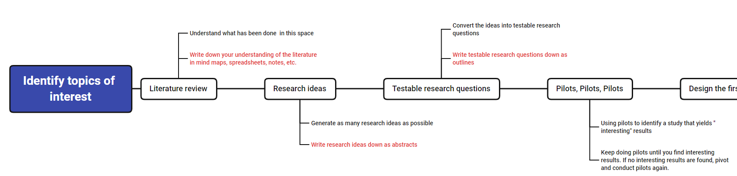
Next steps
After we get several interesting and feasible problem to work on, what we do next?
Notes:
So after we get several interesting and feasible problem to work on, what should we do next?
Design and conduct a pilot study to test if the result is interesting and promising

Slide 20
Pilot study
What is pilot study?
Definition:
Pilot study is a quick and dirty test on a small scale of users to evaluate the interestingness, effectiveness and feasibility of the result of the method/hypothesis.
Notes:
In our last class about the Artefact research, prof mentioned many time about the importance of pilot study, so first what is pilot study?
Purpose is to build up a simple and small-scale test before the complicate full-scale test
To find out if the problem is the interesting, if the method is effective and feasible.

Slide 21
Pilot study
Why is it important?
Pilot study is the best way to assess feasibility of a large, expensive full-scale study, and in fact is an almost essential prerequisite. Conducting a pilot prior to the main study can enhance the likelihood of success of the main study and potentially help to avoid doomed main studies.
What should we consider in pilot study?
Time saving (Quick & dirty)
Reliable (avoid bias)
Notes:
Why is it important?
Pilot study is the best way to assess feasibility of a large, expensive full-scale study, and in fact is an almost essential prerequisite. Conducting a pilot prior to the main study can enhance the likelihood of success of the main study and potentially help to avoid doomed main studies.
What should we consider in pilot study?
First is time saving(quick and dirty). So the pilot study needs to be quick and dirty so that we can have a Marco overview of the result in a short time and see if it can work. We will talk about the meaning and example of quick and dirty pilot study in the next page.
Although pilot study is a small scale and quick study, we need to make sure the result of pilot study is reliable. Which means the result of the pilot study should represent what we might get in the large scale study. We want to avoid any potential bias in the pilot study procedure.

Slide 22
Pilot study design
What does it mean by quick & dirty?
Check the interestingness of the results using minimum efforts/time
Test the ideas with real users using low fidelity alternatives or wizard of oz methods
The goal is to check your hypothesis and decide whether the results are interesting enough
Notes:
First is Check the interestingness of the results using minimum efforts/time
Which refer to the time saving we talked about.
To get the result we need, we should test the ideas with real users using low fidelity alternatives or wizard of oz methods.
Our goal is to check your hypothesis and decide whether the results are interesting enough.

Slide 23



What is a Wizard of Oz study?
Definition: Using a human wizard to mimic certain operations of a potential system
input
input
feedback
feedback
Notes:
So literally Wizard of OZ is a fairy tale which we probably read when we was a child. And in the story OZ is a wizard with no magic. So in HCI study what is a wizard of OZ study?
The common HCI process contain 2 steps, first human gives the smart device an input and then the smart device gives human a feedback. Just like what’s shown in the left figure. So the programming of a smart device is time consuming. The purpose is to test the reaction of the user when using a certain device. So what WOZ do is replace the smart device with human without letting users know. In that case, we can collect the user’s experience and feedback without the time-consuming coding.

Slide 24
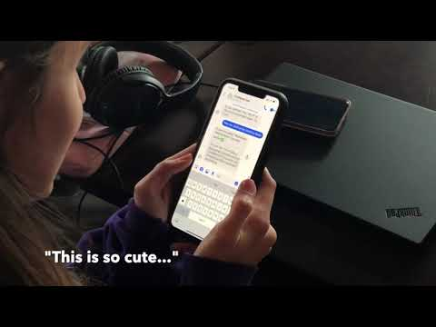
What is a Wizard of Oz study?
Notes:
So in this situation, we can see that the human is using the smart “note taking” system and the human is giving respond without letting the girl know.

Slide 25



An example that can be quickly tested
Your hand
Notes:
Here is an example that can be quickly tested.
In the VR system, it’s hard for us to point to a specific point accurately. Researchers want to find out if using a fake hand pointing to the point can help users to take faster and more accurate actions.

Slide 26
Questions
Q1: What is the hypothesis?
Q2: how to test this hypothesis in a quick and dirty
way without writing coding?
Your hand
Notes:
The fake hand can help us find the 3D location of an item.
Set up a scene in the real world similar to the VR world, using the hand of another person to mimic the fake hand and point to a ball in the real world to see if the user can point to the ball in a shorter time.

Slide 27
Another example
Help consumers in the shopping mall find the shop destination while following the digital map direction for a convenient shopping experience.
Q1: What is the hypothesis?
Q2: how to test this hypothesis in a quick and dirty way
without writing coding?
Notes:
WoZ methods
Digital map and direction can lead the consumer to the shop quicker and gets good feedback from the consumer
Using human to pretend the smart device and give instructions and directions to the consumer.
So based on the two examples, we can see that some problems can be quickly tested by yourself or by a few users in a simple way without coding.

Slide 28
The multiple stages of pilot tests
Stage 1: Is the problem promising?
Stage 2: Detailed examination
Notes:
So after we gets a view about what is pilot study and why it’s important, we not look into multiple stages of conducting a pilot tests.

Slide 29
Is the problem promising?
It contain 3 sub-stages.
Stage 1.1 pre-pre-pilot: does the problem have a chance?
The purpose of this stage is to have a sense whether this problem has a chance to be interesting
At this stage, you try to test yourself. You don’t even need to explicitly measure the performance. Just have an intuitive feeling to see whether there is a chance.
Many ideas can be eliminated at this stage
Stage 1.2 pre-pilot: it feels good when testing with yourself, now let’s test with some real users
Design quick and dirty pilot use some very rough measures and test with 2-3 people
What does the result look like, does it matches your own feeling? Do you see any large effects?
If the results looks promising
Rule of thumb: spend no more than 1 day on this stage
Stage 1.3 pilot: it looks promising, now let’s do a real pilot with 4-6 people
It should follow a protocol that ensure fair testing
Try to collect both quantitative and qualitative measures with reasonable accuracy
More formally analyze the results
Notes:
There are two subsub stage, The first stage is to consider if we do have a chance, so the purpose is to have a rough feeling of if the idea works. so what we do in this stage?
p2 try the hypothesis on your self or friends to see the effect.
p3 write study plan, more formal analysis.

Slide 30
Detailed examination
Now we know we have something to work with, it’s time to fill in the details. For a full paper, typically we need to identify
Stage 2.1 exploration pilots: what are the relevant factors?
The goal is to find at least 2, but less than 6 factors (other than the main factor) that can influence the result. The richness of the paper depends on this sub-stage
At this stage, you brainstorm and run multiple pilots to determine these interesting factors based on the results
Stage 2.2 confirmation pilots: put everything together and confirm
Assuming you have find a few interesting factors, you still need to put them into one or more full study and run pilots to confirm the entire study design works and make sense
Notes:
Now lets move to detailed examination, so to create something really useful and make it a full paper, only performance superior is not enough, the paper needs to be comprehensive on solving a certain problem.
So what we need to do is to find the relevant factors of a certain problem, a problem cannot be only effected by one factor. Look into those factors and see if we can find sth interesting to support our hypo or to benefit the problem. The more interesting factors you find, the more likely you can improve the present interactive mode.
The second stage is to put everything together and confirmwith some more study and maybe move on to the full study part.
This process looks complicated, but the good news is that in reality, you typically only need to focus on stage 1(promising check). Once stage 1 is passed, the lessons you learned in stage 1 will naturally help you to find the relevant factors in stage 2.

Slide 31
Level of details in pilot design
The pilot design depends on which stage you are at
Stage 1.1: no need formal design, just do it
Stage 1.2: some design is needed, but can be informal
Think about who you want to test, the order of testing, the measures you want to collect, the instructions you want to give, etc.
Stage 1.3: a more formal design is needed, write an outline for it
Example: group assignment description
Notes:
Stage 1.1 pre-pre-pilot: does the problem have a chance?
Stage 1.2 pre-pilot: it feels good when testing with yourself, now let’s test with some real users
get some one who can represent the group. order of testing?
Stage 1.3 pilot: it looks promising, now let’s do a real pilot with 4-6 people

Slide 32
PilotAR

Slide 33
Thank you!

